Slide 1

Team Name: Fusion
Team Number: 420

Slide 2

ABSTRACT
FemmeRise is a vibrant online hub dedicated to championing the rights of women across India. With a compelling blend of informative resources, inspiring stories, and interactive features, our platform is poised to spark change and elevate the voices of women everywhere. Delve into our comprehensive sections covering pivotal topics such as domestic violence and the challenges faced by working women in corporate sectors. Discover a wealth of knowledge on legal rights, workplace equality, and avenues for support, all tailored to empower women in their pursuit of justice and equality. Engage with our community forums, where women from diverse backgrounds come together to share experiences, seek guidance, and offer unwavering support. Be inspired by riveting success stories that celebrate the resilience and triumphs of women breaking barriers and reshaping society. Embark on a journey of awareness and advocacy through our impactful campaigns and events, rallying individuals and policymakers alike to embrace gender equality and enact meaningful change. With its captivating multimedia content, user-friendly interface, and commitment to inclusivity, FemmeRise stands as a beacon of empowerment and solidarity for women across India. Join us in rewriting the narrative and shaping a future where every woman's rights are respected, valued, and protected."

Slide 3
PROBLEM SOLVED
Problem: Women in India face various challenges including domestic violence, workplace discrimination, and lack of awareness about their legal rights

Slide 4
PROPOSED SOLUTION
Solution: FemmeRise addresses these challenges by providing a comprehensive platform that offers:
Informational Resources: Accessible information on legal rights, workplace equality, and avenues for support empowers women to understand and assert their rights.
Supportive Community: Community forums provide a safe space for women to share experiences, seek guidance, and offer support to one another, fostering solidarity and resilience.
Awareness Campaigns: Impactful campaigns and events raise awareness about women's rights issues, rallying individuals and policymakers to advocate for gender equality and enact meaningful change.
Success Stories: Inspiring success stories celebrate the resilience and triumphs of women who have overcome barriers, inspiring others and reshaping societal norms.
Legal Aid: Direct access to legal resources and assistance helps women navigate legal processes related to domestic violence, workplace discrimination, and other challenges.
Multimedia Content: Engaging multimedia content including videos, podcasts, and infographics ensures information is accessible and appealing to diverse audiences.

Slide 5
TECH STACK
Frontend: HTML, CSS, JavaScript, React.js or Angular.
Backend: Node.js .
Database: MongoDB.
Authentication: Passport.js (for Node.js) .
Hosting: Heroku.
Deployment: Docker.

Slide 6
Our aim is to reach out to a diverse group of women, spanning different ages, educational backgrounds, and socio-economic statuses. Unfortunately, many of these women are currently unaware of their rights. This includes young women who are navigating their way through education and early careers, mothers who are juggling familial responsibilities with professional aspirations, and women from marginalized communities who are facing systemic barriers. Despite their education levels, many women have limited access to information and resources that would help them to assert their rights confidently. Our goal is to bridge this gap by providing accessible and tailored tools and information that resonate with the unique needs and challenges of each segment of our target audience. Ultimately, we hope to foster greater awareness, autonomy, and agency among women in their pursuit of equality and justice.
Our aim is to reach out to a diverse group of women, spanning different ages, educational backgrounds,
and socio-economic statuses. Unfortunately, many of these women are currently unaware of their rights.
This includes young women who are navigating their way through education and early careers, mothers
who are juggling familial responsibilities with professional aspirations, and women from
marginalized communities who are facing systemic barriers. Despite their education levels, many women
have limited access to information and resources that would help them to assert their rights confidently.
Our goal is to bridge this gap by providing accessible and tailored tools and information that resonate
with the unique needs and challenges of each segment of our target audience. Ultimately, we hope to
foster greater awareness, autonomy, and agency among women in their pursuit of equality and justice.
TARGET AUDIENCE
Who are the customers you want to cater to?

Slide 7
PROGRESS REPORT
We are pleased to report significant progress in the development of FemmeRise . Over the reporting period, our team has successfully completed the front page design, established the database infrastructure, and created insightful dashboards to provide valuable data analysis.
Our project's front page has been designed with utmost care to engage users and provide a seamless user experience. Our design team has focused on creating an intuitive interface that effectively showcases key information and navigational elements.
We have made significant progress in setting up the database infrastructure to store and manage the project's data efficiently. This includes designing the database schema, implementing data models, and ensuring scalability and reliability.
Our team has developed comprehensive insights dashboards that offer valuable data analysis and visualization capabilities. These dashboards provide stakeholders with actionable insights into key metrics, trends, and patterns, empowering informed decision-making.
Moving forward, we will continue to build upon the foundation laid during this reporting period. Our focus will be on refining the front page design, optimizing database performance, and enhancing the insights dashboards with additional features and functionalities.
Additionally, we remain mindful of the need to prioritize data security, user privacy, and accessibility considerations throughout the development process.
WHAT HAVE YOU DONE ?
WHAT ARE YOU PLANNING TO DO ?

Slide 8
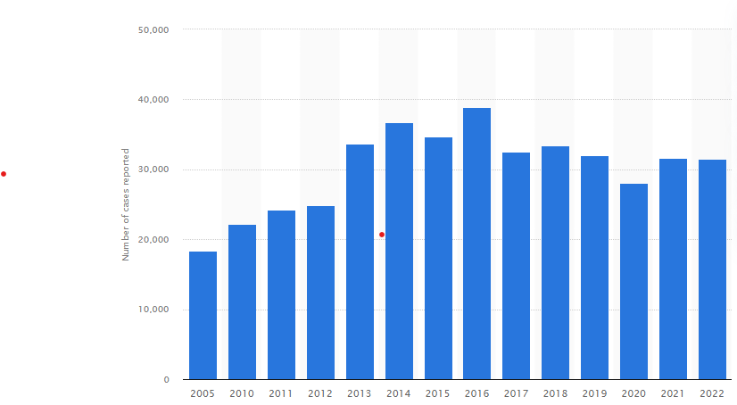
Dbgv
The total number of reported rape cases in India
from 2005 to 2022 varies annually and reflects a
complex issue within the country's social and legal
framework.
DASHBOARDS

Slide 9
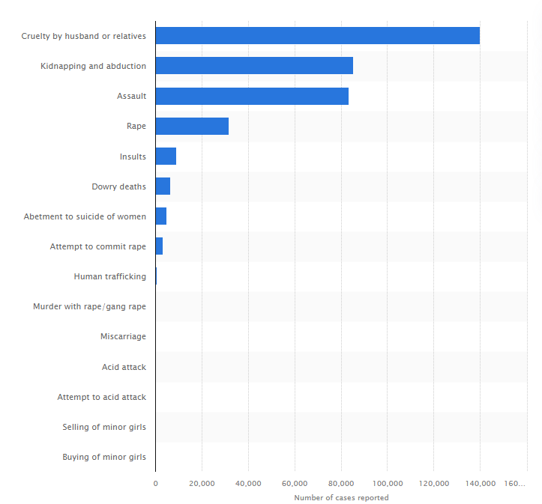

Number of reported crimes against women across India in 2022, by type of crime
The number of reported crimes against women across
India varied by type of Crimes such as rape, domestic
violence , sexual harassment, dowry-related offenses,
and others contribute to the broader landscape of
gender-base violence. Understanding the distribution and
prevalence of these crimes is crucial for policymakers,
law enforcement agencies, and organizations working to
address gender inequality and ensure the safety and
well-being of women in society.

Slide 10
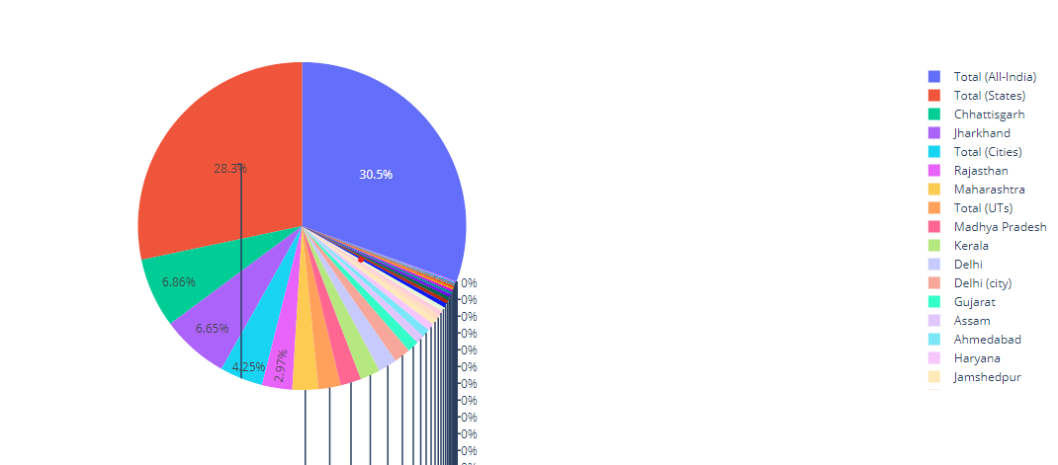
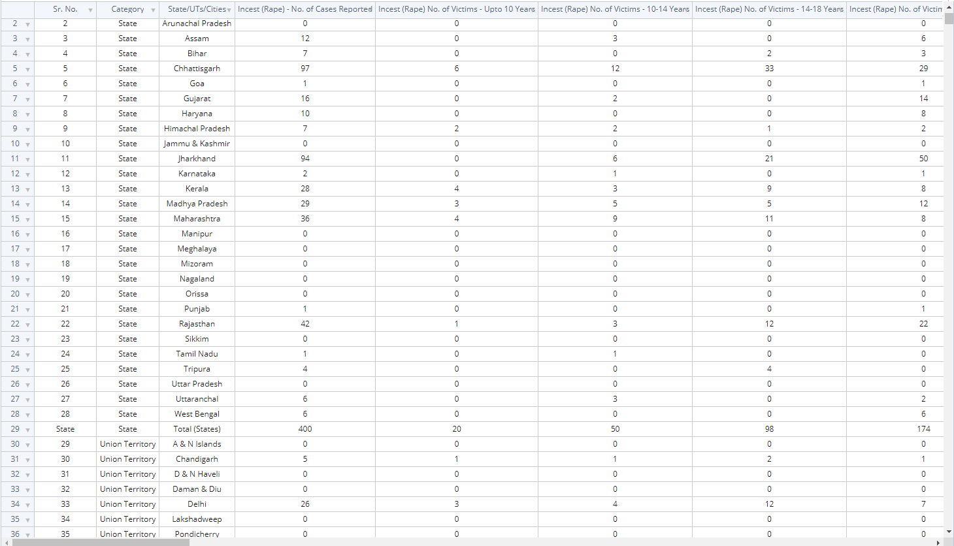
Below is the dataset detailing reported crimes against women across India in 2022, categorized by type of crime. Additionally, a pie chart illustrates the distribution of reported rape cases among states in India.
And we have follow it up with the dataset and the corresponding pie chart.

Slide 11
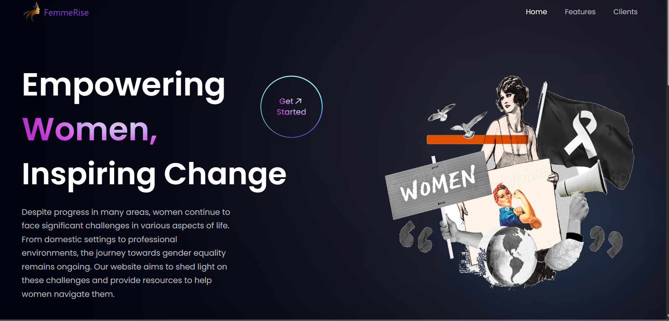
SCREENSHOTS / IMAGES

Slide 12
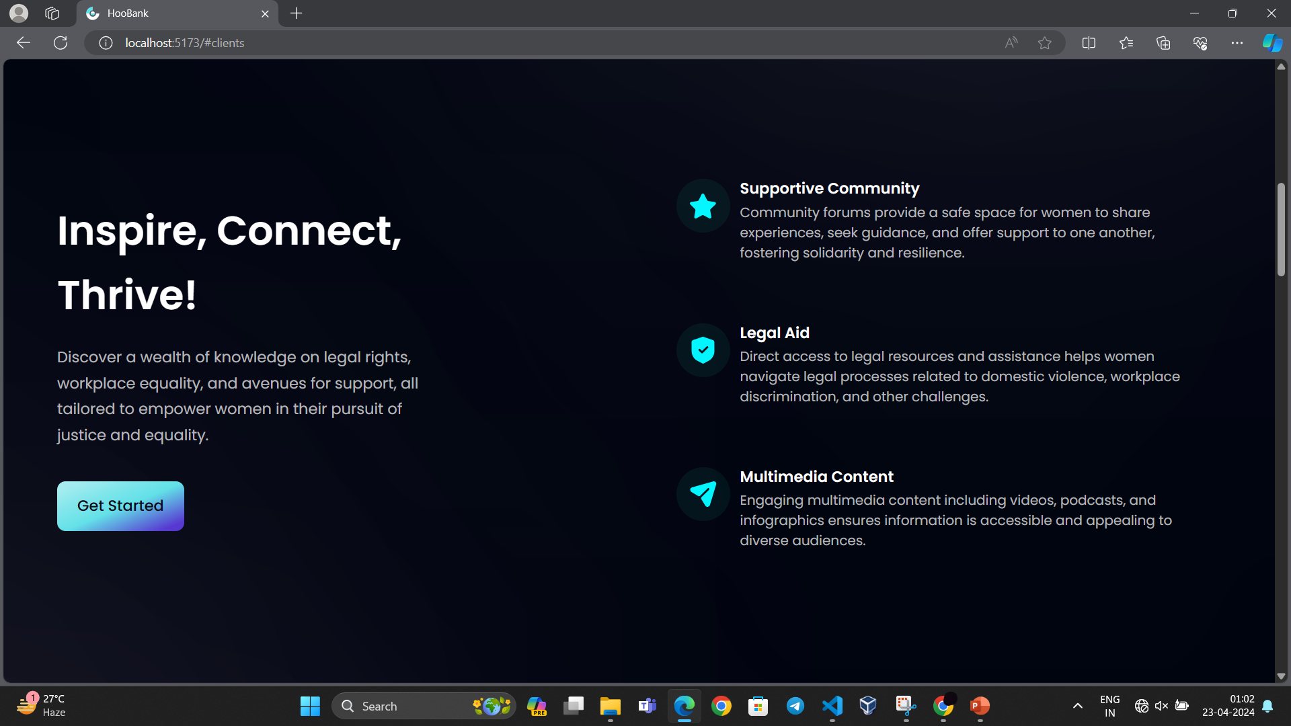

Slide 13
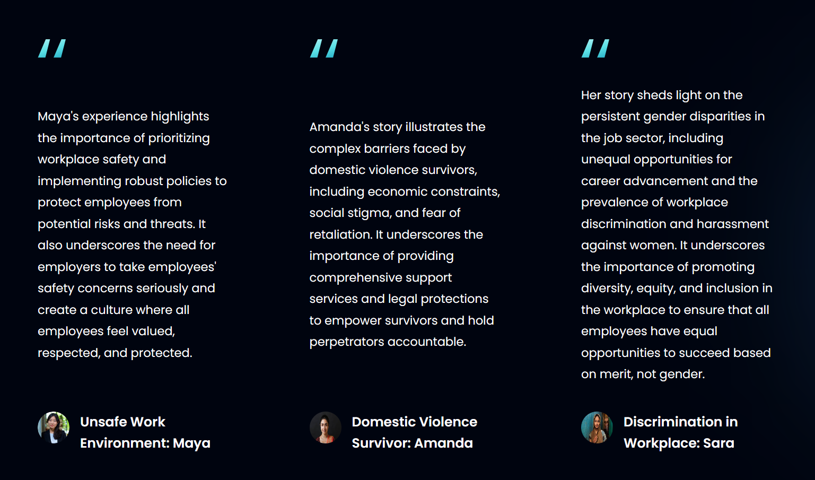

Slide 14



Thank You

